Slide 1
Step by Step Instructions to View ESEA Consolidated Plans
Go to the DESE web application log-in page (directly at apps.dese.mo.gov/WebLogin/Login.aspx or from the DESE homepage at https://dese.mo.gov then choose “Web application”.)
Choose “View Public Application”
Choose “ePeGS”
Choose the appropriate Charter LEA by using code or alphabetical listing. Press “Select”
Choose “Funding Application” from side menu or center menu
Choose “Quality Schools” from side menu or center menu
Choose “ESEA Consolidated” from side menu or center menu
Choose “Budget Application View”
Choose latest approved Version
Choose “ESEA Consolidated Plan” from side menu
Choose “School Level”
Choose the school that you would like to view.
Choose the View Button beside which portion(s) of the plan that you would like to see
Choose “Print Preview” - this will allow you to see the plan on screen or you can choose to “Print” the plan.

Slide 2
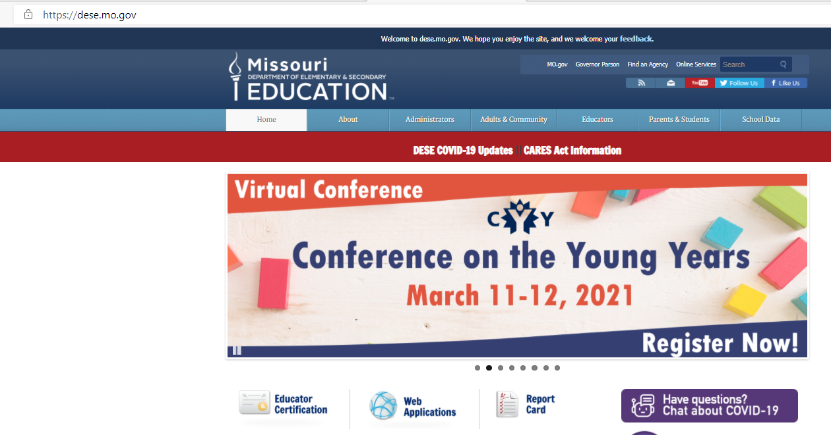

Slide 3
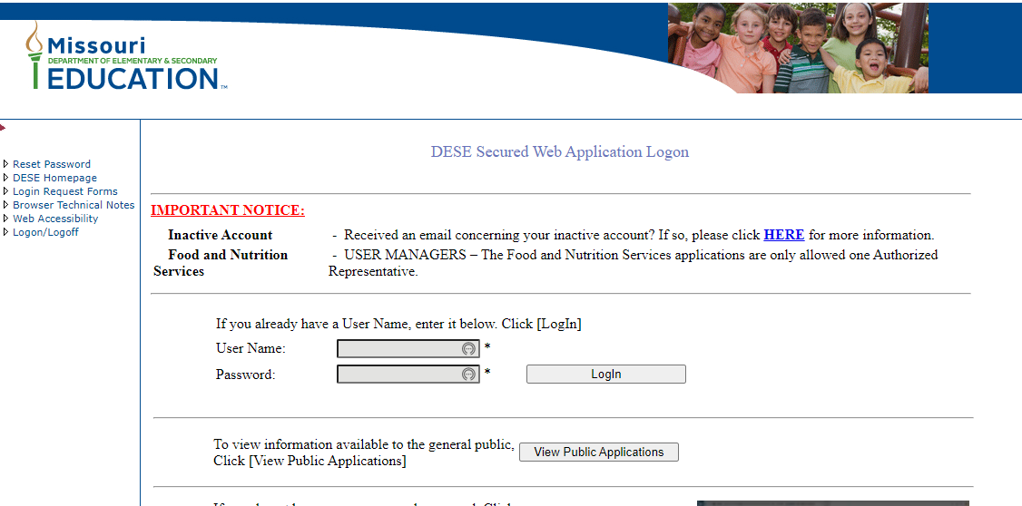

Slide 5
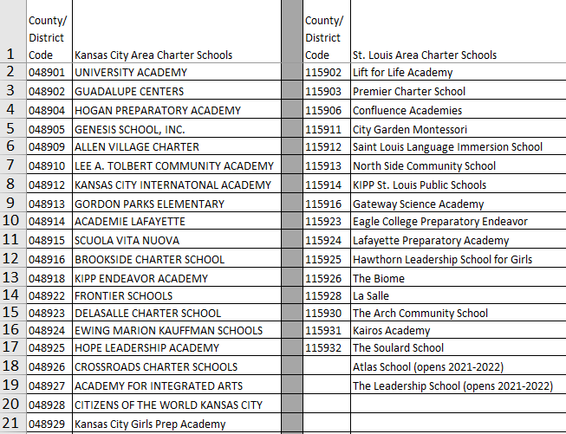

Slide 6
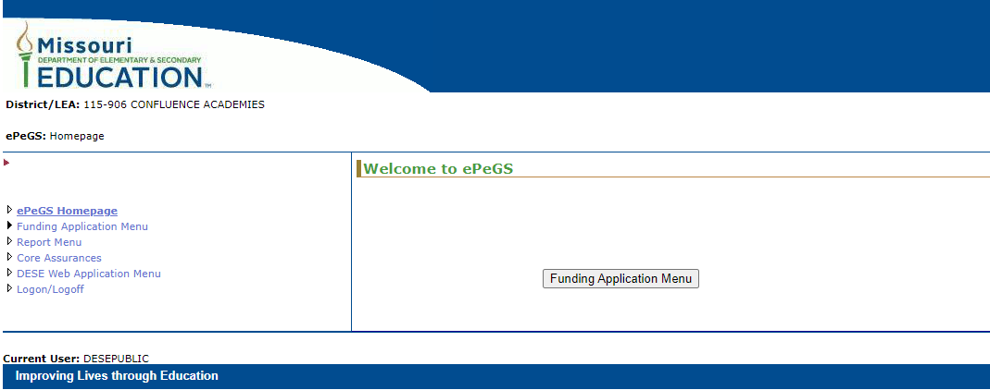

Slide 7
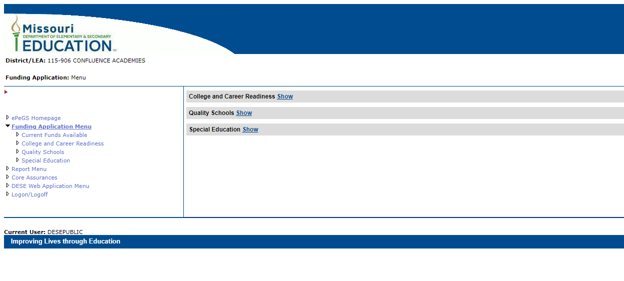

Slide 8
